Slide 1
Research communications
At the University of Arkansas

Slide 2
University relations
A comprehensive communications office for campus.
Writers, editors, designers and web.
Disseminate information to many audiences.
Our office produces more than 1,000 news releases, websites, publications, videos and other communications pieces each year.

Slide 3
Science and research communications
Melissa Lutz Blouin, senior director of academic communications
Barbara Jaquish, science and research communications officer
Matt McGowan, science and research communications officer

Slide 4
Our mission
(Should we choose to accept it…)

Slide 5
Mission
Support the University of Arkansas in the Transparency and Accountability (TAP) goals.
Support the university in its quest to become one of the top public universities in the nation.
Support the university in its quest to boost morale and support among its internal and external stakeholders.

Slide 6
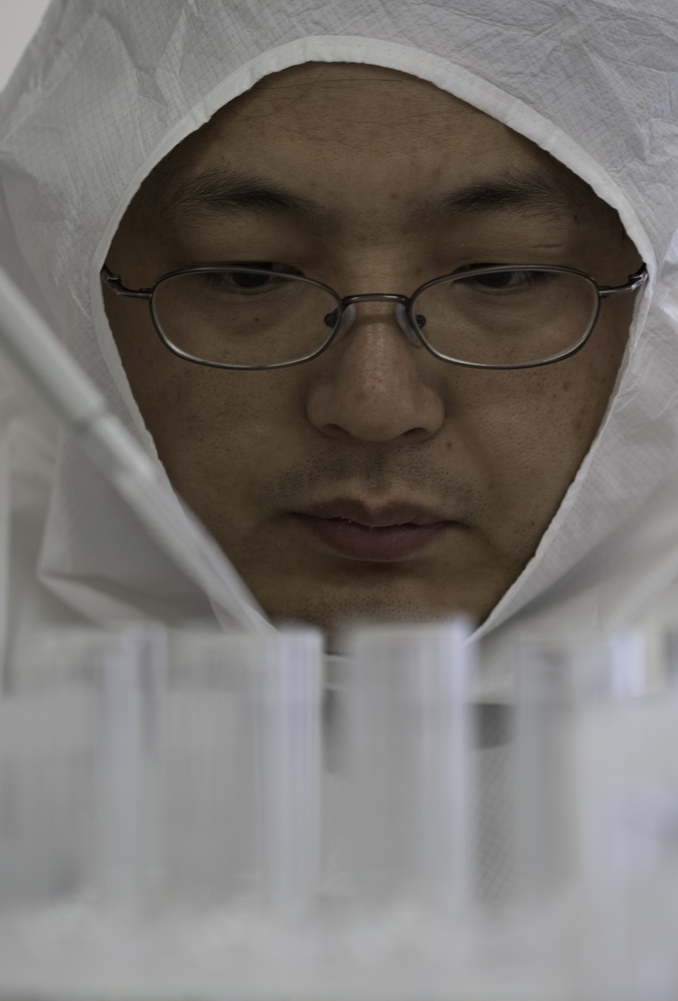
What?
What interests people?

Slide 7
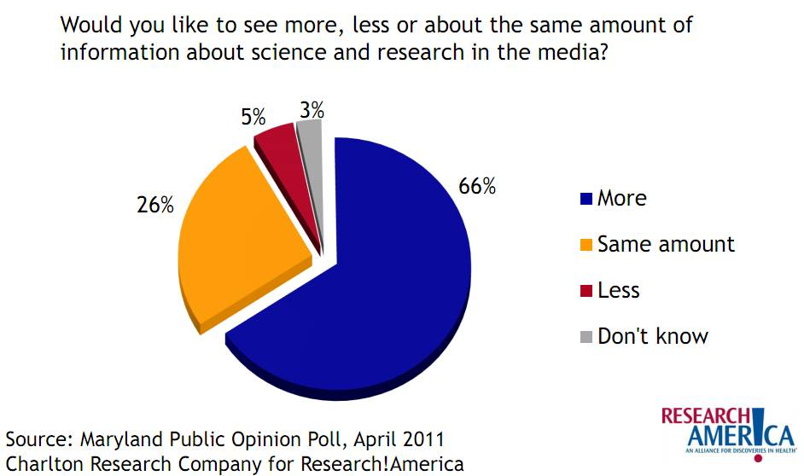
Why? Public interest

Slide 8
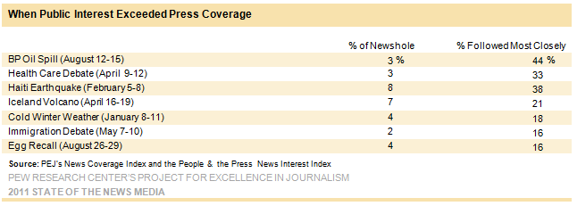
More public interest

Slide 9
Changing media landscape
Science news sections have disappeared
Science blogs have sprung up in their place
Many science writers are now freelancers

Slide 10
Proactive communications
Media relations
Direct communications
Collaborations

Slide 11
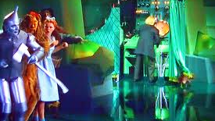
How it works

Slide 12

How? Our tools
News releases
News pitches
Research Frontiers
Experts list
Videos
Social media

Slide 13

News releases

Slide 14
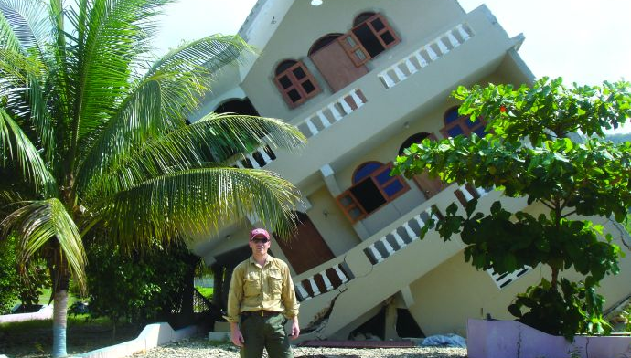
Expert commentary

Slide 15

Research magazine

Slide 16
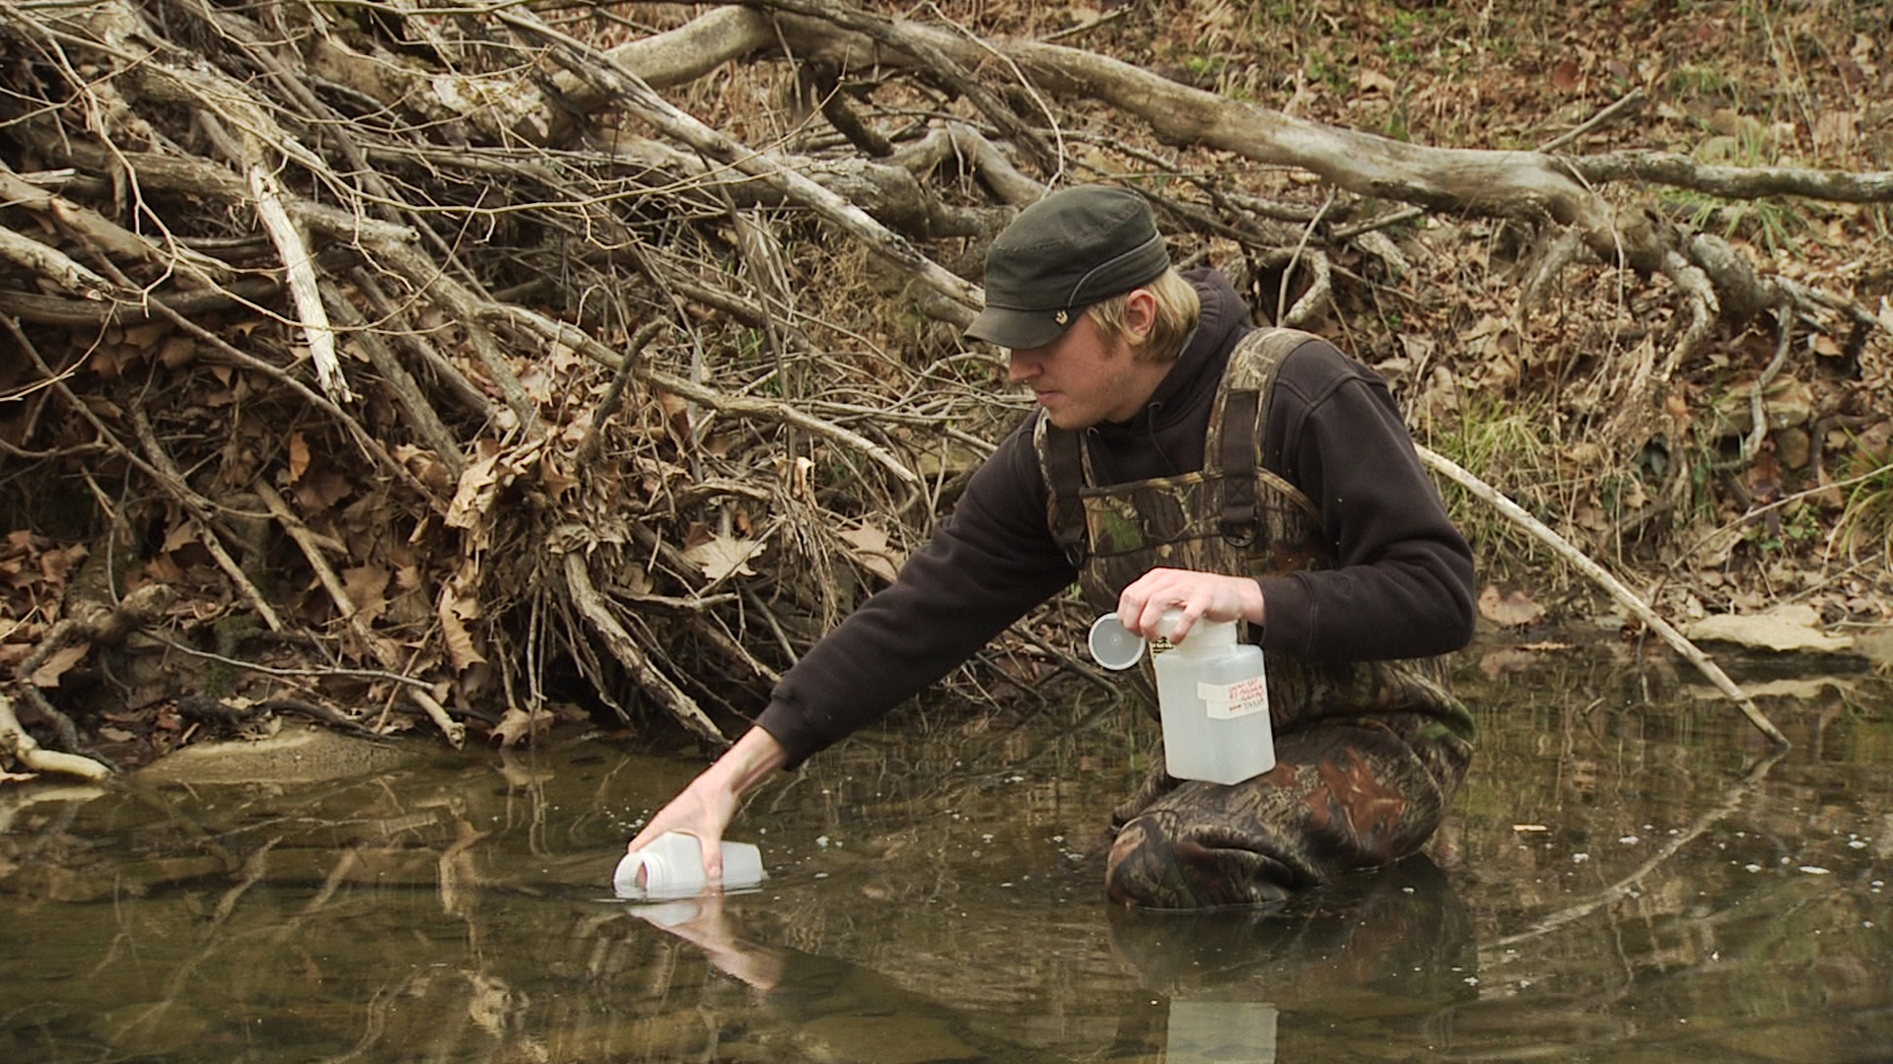
video

Slide 17
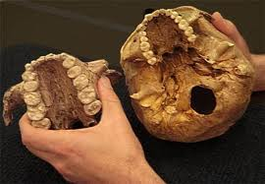
Collaborations
Government agencies
Non-profit agencies
Other institutions

Slide 18
Who? Audiences
National
International
State
Local
Internal
US News decision makers
State legislators
Potential students
Professors
Potential donors

Slide 19
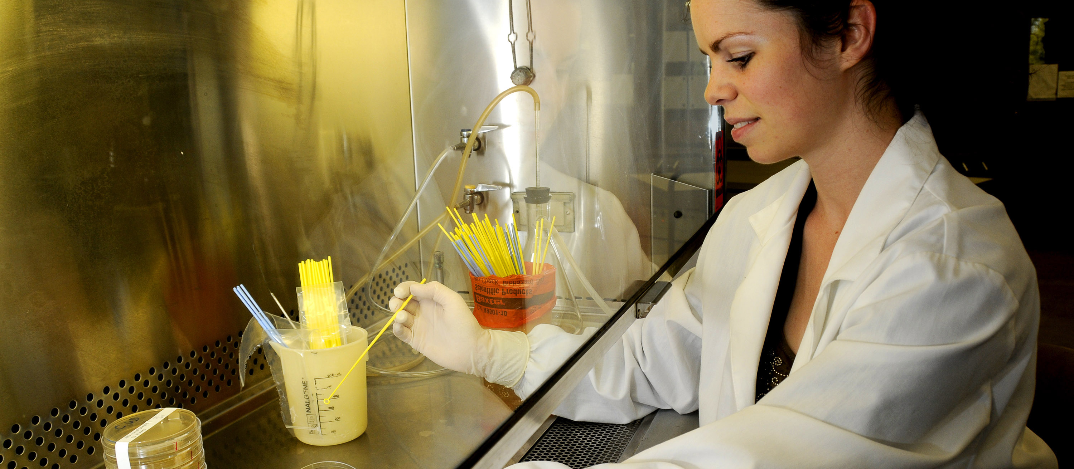
When?
Research or scholarship that is being published in a peer-reviewed journal or presented at a national meeting.

Slide 20
Thank you!
Questions?

Slide 21
Resources
Slime molds creep into the New York Times
http://blogs.discovermagazine.com/loom/
Eumycetezoan Project
http://slimemold.uark.edu/
http://ksjtracker.mit.edu/
NYTimes: Slime molds on deadline; Alzheimer’s and addiction updates; Pathological altruism…
http://ksjtracker.mit.edu/2011/10/04/nytimes-slime-molds-on-deadline-alzheimers-and-addiction-updates-pathological-altruism/
Large Field of Dinosaur Tracks Uncovered in Southwest Arkansas
http://newswire.uark.edu/article.aspx?id=16922
Can Answers to Evolution Be Found in Slime?
http://www.nytimes.com/pages/science/index.html
Fayetteville as in Fate
http://researchfrontiers.uark.edu/15932.php

