Slide 1
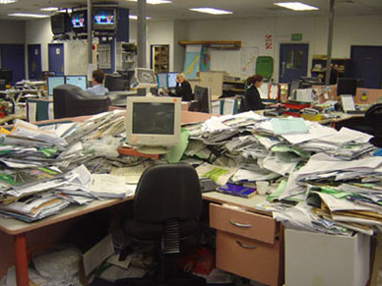
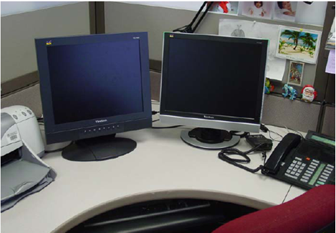
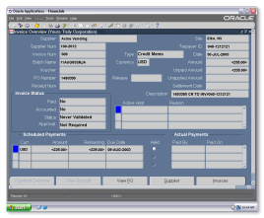
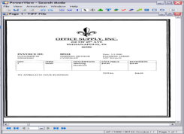
This is your desk on paper.
This is your desk on Perceptive Software products.

Slide 2
Perceptive Content (ImageNow) Overview
Peter Hine
Manager – Imaging & Workflow
University IT Services
Carla Hefner
Solutions Manager
Nathan Wust
Technical Manager

Slide 3
Product Platform Overview
USERS
Put processes and content in the context of your enterprise applications
YOUR ENTERPRISE APPLICATIONS
Capture and extract data through imaging, e-forms and intelligent capture technologies
Manage all forms of content through their entire lifecycle
Discover, design, execute and improve business processes
Search, find, extract, analyze and use the precise information needed
A strong technical foundation for today, and a complete system for future growth

Slide 4
Enterprise Content Management Functionality
Document Management
MS Office plug-in
Robust searching
Document security
Digital signatures
eForms
Standards-based forms
Easy portal integration
Customize based on user role
Document Imaging
Distributed capture
Automated linking
Content extraction
Records and Information Management
Retention policy admin
Automated dispositions
Legal/audit holds
Workflow
User-friendly WF designer
Powerful rules engine
Task-based and document centric styles
solutions
products
platform
Notes:
4

Slide 5
Higher Education Solutions
Administration
3
Advancement
4
Student Services
5
Donor Management / Development
Alumni Affairs
Foundation
Perceptive Software Solutions
Perceptive Software Solutions
Perceptive Software Solutions
Residential Life
Dining Services
Health Clinic
Judicial Affairs
Facilities
Student Affairs
Contract Management
Sponsored Research
Executive Meetings
Correspondence Processing
Policy Administration
IT Administration
IT Development
Gift Processing
Proposal Management
Events Management
Endowment Management
Housing Assignment
Facilities Maintenance
Academic Advising
Student Health
Disciplinary Action
Student Organizations
Campus Safety & Police
Disability Services
President’s Office
VP Offices
Grants & Contracts
Research
Information Technology
7
Human Resources
2
Accounts Payable
6
Perceptive Software Solutions
Perceptive Software Solutions
Procurement Processing
Invoice Processing
Expense Report Processing
Recruitment
Onboarding
Employee & Manager Self-Service
Employee Management
Audit
Faculty Credentialing
Search Committee
Requisition Processing
Invoice “Scan & Link” Processing
Automated Invoice Processing
Advanced OCR Invoice Processing
Travel & Expense
Check Capture
Recruitment
HR Business Partners
Payroll
Employee Relations
Compliance
6
3
4
7
Athletics
Compliance
Advancement
Recruitment
Coaching
Events
Enrollment Services
1
2
Perceptive Software Solutions
Perceptive Software Solutions
Athletics Compliance
Athletics Advancement
Recruiting
Coaching
Ticketing & Events
Undergrad Admission
Graduate Admissions
Financial Aid
Registrar
Student Financial Services (Bursar)
Admissions Evaluation
Transcript Processing
Financial Aid Awarding
Student Records
Graduation Audit
Billing & Collections
5
1

Slide 6
Perceptive Content (ImageNow) Overview
CAPTURE
ORGANIZE
PO Req
Invoice Processing
AR
PROCESS
RETRIEVE

Slide 7
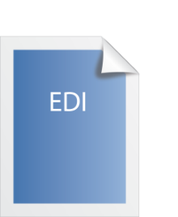
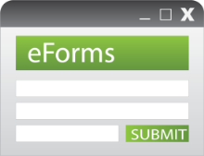
CAPTURE
Scanned Documents
EDI
File Import
Data Extraction
E-Mail
Microsoft SharePoint
ImageNow
Faxes
MFPs
Microsoft Office
E-forms

Slide 8
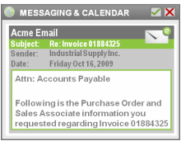
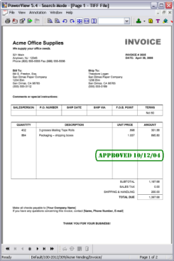
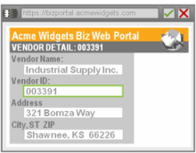
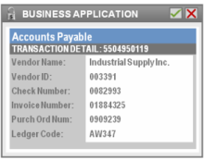
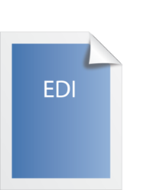
ORGANIZE

Slide 9
PROCESS

Slide 10
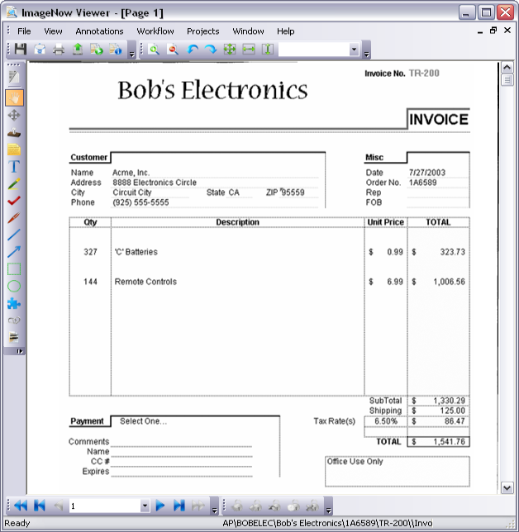
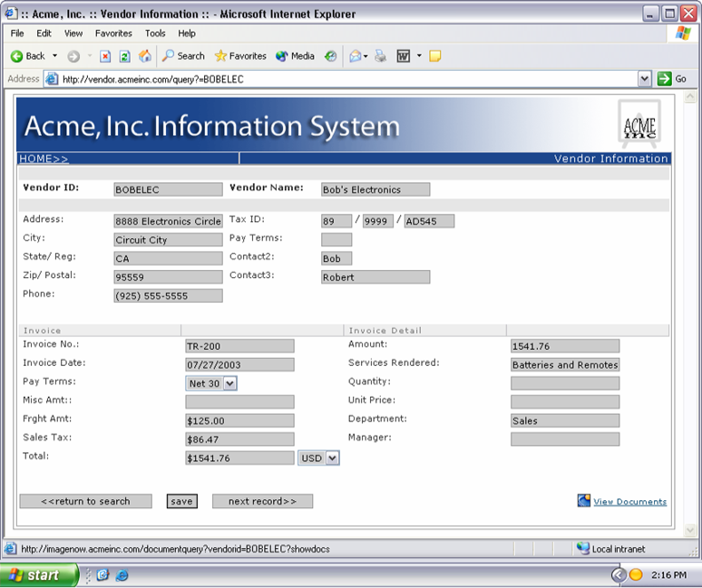
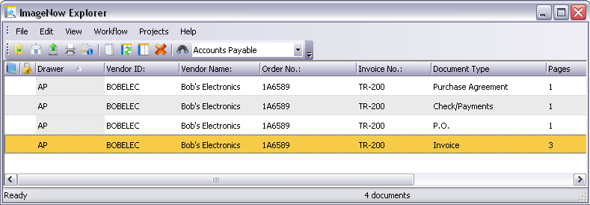
RETRIEVE

Slide 11
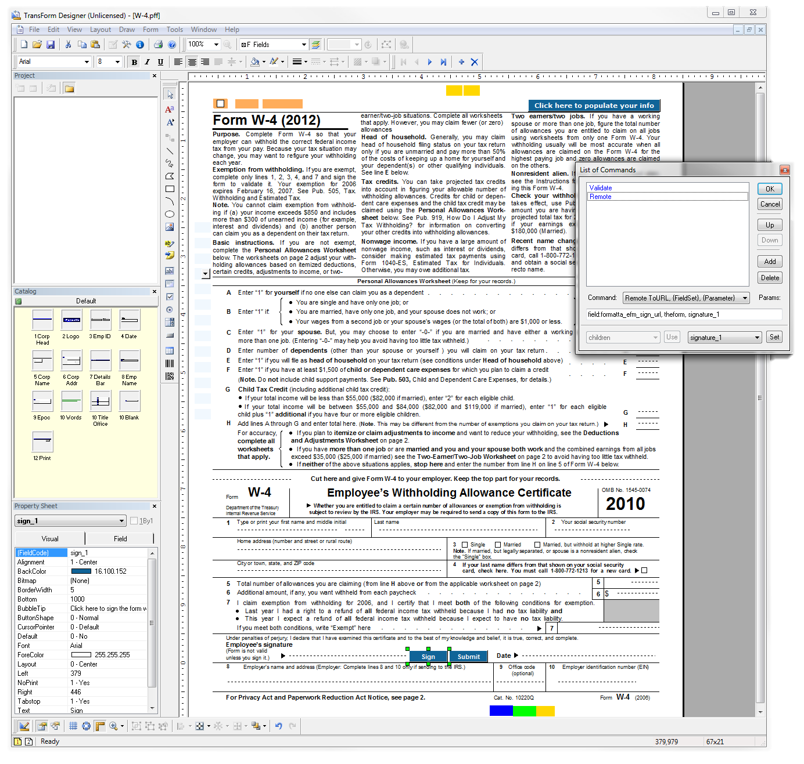
Perceptive TransForm Designer | Easy Form Design
Intuitive & Simple UI
Drag & Drop form development
Rapid design while retaining the look of its paper counterpart
Import from PDF or Design from scratch
Creates Forms which can be locked, signed and versioned
Functions include:
Formulas
Validations
Customizable Events and Commands

Slide 12
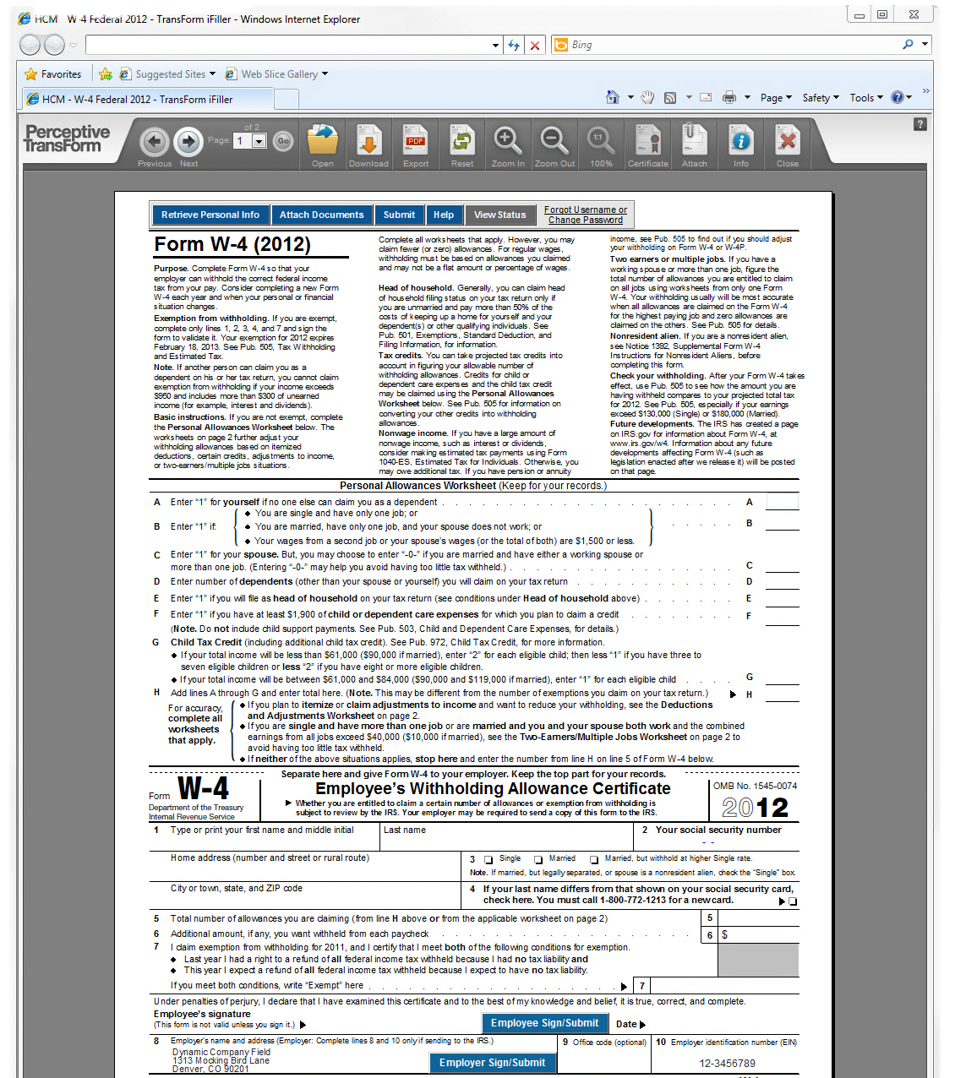
TransForm | Online “iFiller”
Server application for online browser-based form access. Has the following support when accessed via web browser:
Browser Support:
IE
Safari
Opera
FireFox
Chrome
OS Support:
Windows
OS X
Linux
Mobile & Tablet Support:
iPhone
iPad
Native AJAX + XHTML
No Plugins + Client-Side JAVA Requirements

Slide 13
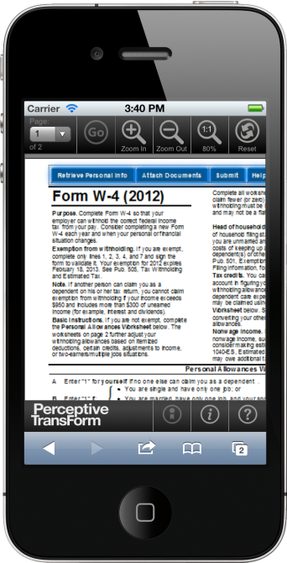
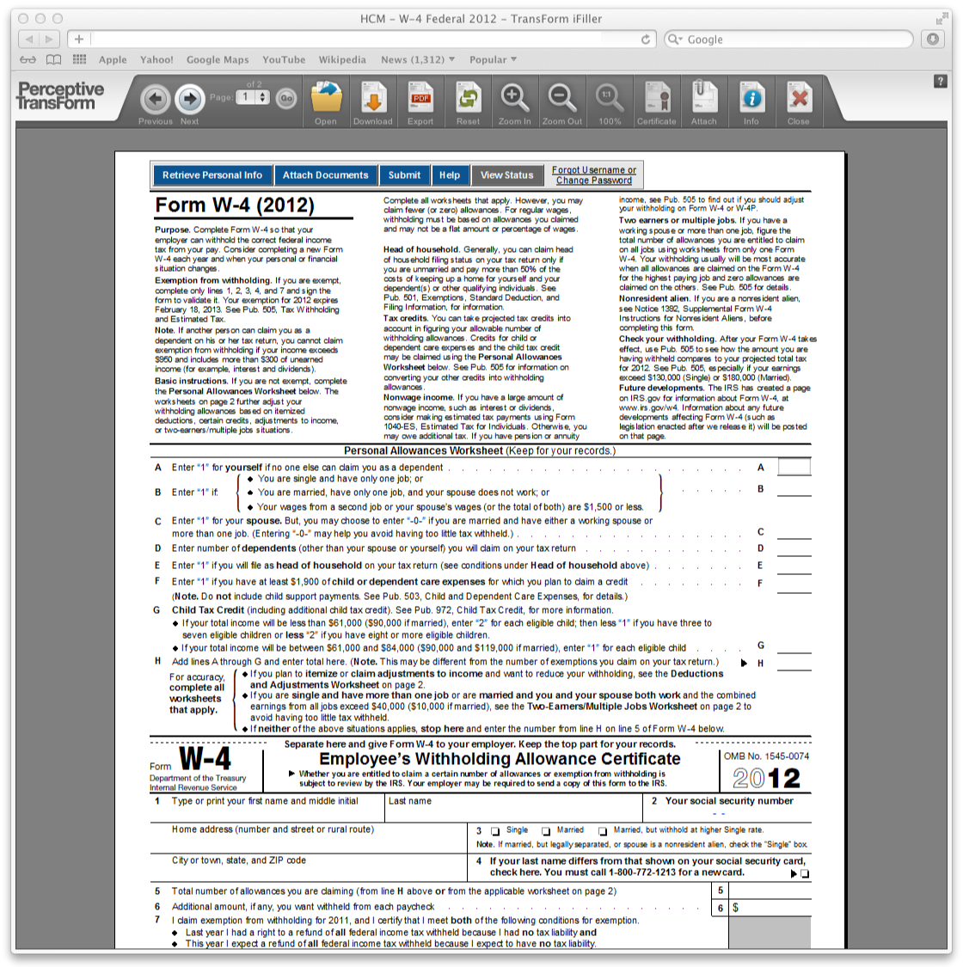
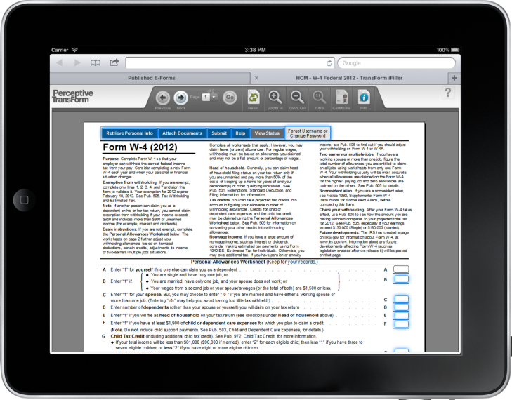
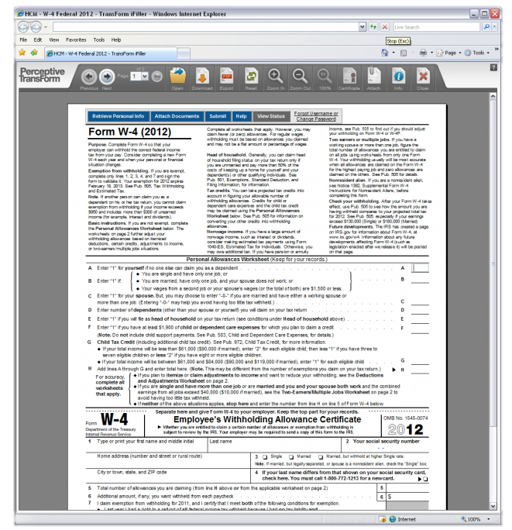
TransForm | Cross Platform + Browser Support
iPad
Safari
iPhone
IE7
Forms only need to be designed once
Forms are rendered the same across supported OS, web browsers or device type
Includes enhanced smartphone and tablet display
Full touch -based UI for quick access to forms within a mobile or tablet experience

Slide 14
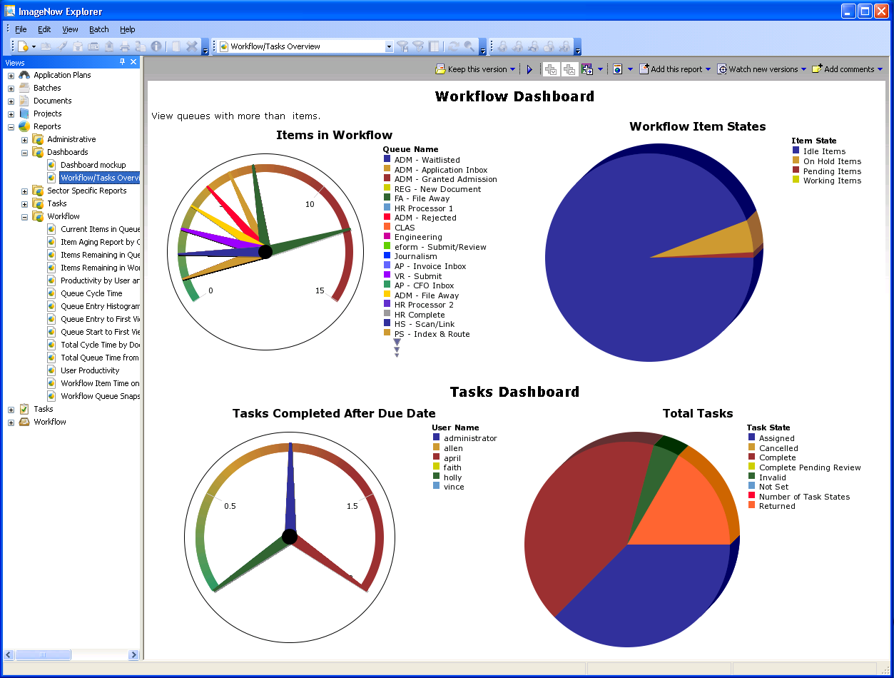
Dashboard through IN Explorer

Slide 15
Transcript Processing Today
Evaluating transfer credits is data intensive
Manual data entry is time consuming and can produce costly errors.
Multiple disjointed processes
Time consuming – students have to wait for information

Slide 16
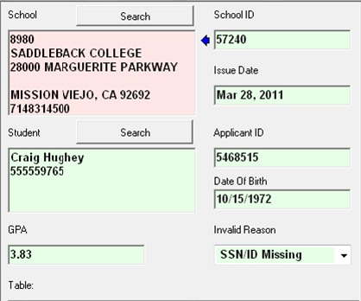
Intelligent Capture for Transcripts Overview
Automatically classify and sort various transcript types and formats.
Capture data without defining templates, zones or anchors.
Reconcile captured data against SIS/ERP
Rich verification includes on-demand search for institutional and student data.
✗“cloud”
✓ “could”
College
High School
Military

Slide 17
What is Perceptive DataTransfer?
A multipurpose batch data load utility
Also called an ETL (Extract – Transform – Load tool)
Currently in use by over 150 clients to load data such as applications, test scores, personnel data and transcript information into host systems.
TRANSFORM
EXTRACT
LOAD

Slide 18
What can it do?
Batch load data from numerous sources (like those text files or database tables) into various host systems with speed and accuracy
Batch load documents by importing and index/linking into Perceptive Content Systems
DataTransfer can setup to scan a system folder, database table or SFTP site for data loading on an automated recurring schedule
Configurable
Bi-Directional
Massage and Verify

Slide 19
eAuthorize Benefits
Remove barriers to signing
No more manual document handoffs
Eliminate delays and manual processing
Know where things stand
Complete and instant visibility
Proactive status notification
Eliminate legal challenges
Complete audit trail for every signature
Fully compliant with ESIGN Act, UETA and EU Directive on Electronic Signatures
Get it right the first time
Ensures accuracy and legibility
Eliminates mistakes and rework

Slide 20
eAuthorize Knowledge Based Authentication - Overview
What it is
Additional functionality within eAuthorize
Additional (optional) verification of a signer’s identity
Signer inputs personal information and then must correctly answer 3 personal questions
What it does
Further validates the authenticity of a signer
Ideal for sensitive documents
What it means
Ability for us to comply with Dept. of Education e-sig standards
Ability to offer electronic signatures for Financial Aid forms

Slide 21
eAuthorize Knowledge Based Authentication - Overview
What it is
Additional functionality within eAuthorize
Additional (optional) verification of a signer’s identity
Signer inputs personal information and then must correctly answer 3 personal questions
What it does
Further validates the authenticity of a signer
Ideal for sensitive documents
What it means
Ability for us to comply with Dept. of Education e-sig standards
Ability to offer electronic signatures for Financial Aid forms

Slide 22
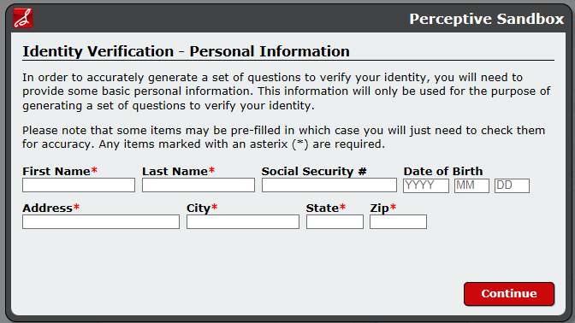
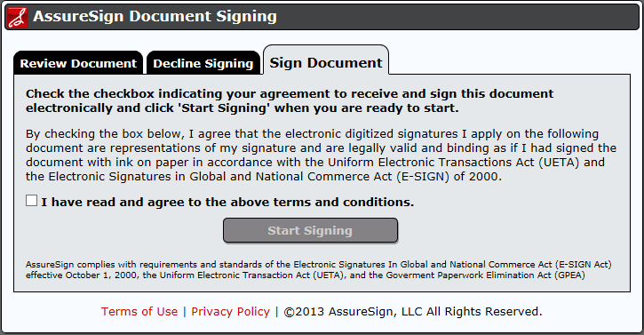
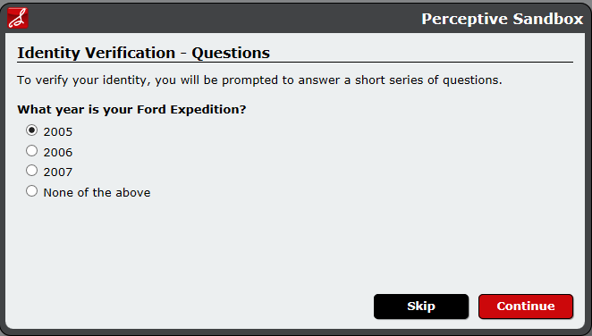
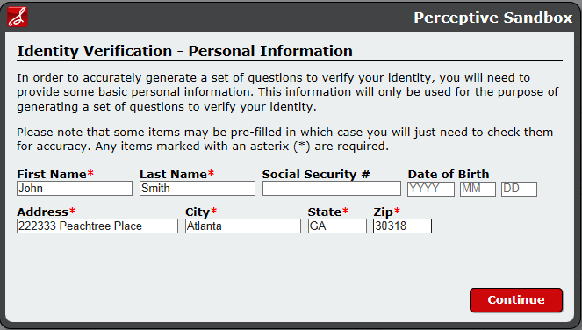
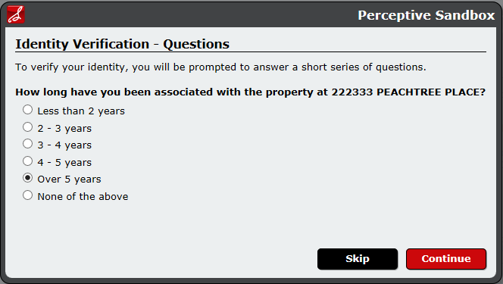
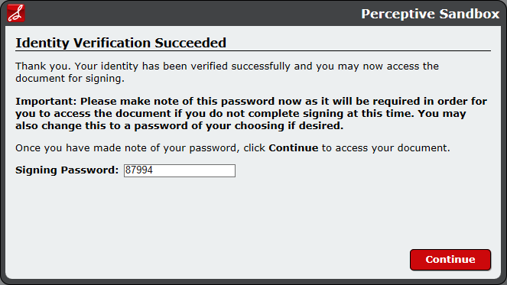
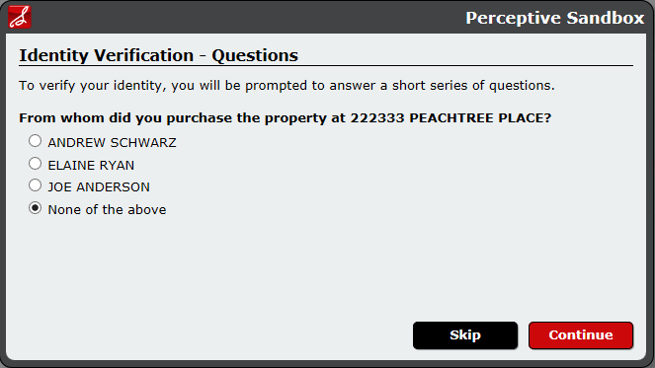
KBA in Action

Slide 23
Kofax Capture
Kofax Capture™ automates and accelerates business processes by capturing all types of paper and electronic documents and forms, transforming them into accurate and actionable information, and delivering it all into core business applications, processes and workflows.
Whether information is on paper or in electronic files, parked at a central office or scattered on desktops and remote offices throughout the world, Kofax Capture can help capture it all.

Slide 24
Kofax Capture - Overview
Speeds processing
Paper and electronic documents are provided consistent rules for indexing and delivering them to ImageNow for quicker processing
Improve Data Accuracy
Advanced recognition technologies with industry leading extraction rates can capture all types of text, including machine print, hand print and cursive handwriting
Process Ready
Patented Kofax VRS technology can intelligently clean, rotate, crop and deskew documents before data is extracted and delivered into business processes

Slide 25
Kofax Capture - Benefits
A Single Solution for Information Capture
Kofax Capture is a powerful, flexible platform that provides a standard and consistent process for securely capturing all types of information
Capture at the Point of Origination
The initial receipt of a document is also the initiation of a process or transaction. Kofax enables organizations to capture this content directly where documents are received
Capture Documents, Data, and More
Kofax Capture delivers the foundation for powerful, production level capture of documents and data from virtually any source: scanner, multi-function printer, print stream, email, fax, web service or file folder

Slide 26
Kofax Capture - Features
Scalable for Growth
Kofax Capture is an enterprise ready, modular application that can be used right out of the box to meet the capture needs of a specific department
Customizable to Meet Your Needs
Kofax Capture can be tailored to support precise business processes

Slide 27
Kofax Capture - Process
Create a Batch
Scan or retrieve your documents
Index the documents
Student and Employee information is available from ISIS and BASIS
Indexing information can be standardized with drop-down lists or database lookups
Verification is available
PDF Generation is available
Export into ImageNow

